Slide 1
Infiltrating Computer Systems
Justin Tyler Hungerbuhler

Slide 2
Topics
Introduction
Hacker Motivations
Computer Reconnaissance
Computer Scanning
Computer Infiltration and Escalation

Slide 3
INTRODUCTION
Based on my paper called “A Study on the Motivations and the Techniques Used to Find, Conduct Reconnaissance On, and Infiltrate Computer Systems”
The term hacker or Cybercriminal is well known at this point, but it does little to describe their allegiance and motivations.
A hacker is someone who gains unauthorized access to a computer system or its data. When describing hackers, they must be separated into different types based on their motivations and their targets.
When a hacker attempts to attack a computer system, they must follow steps or their attack may not work.

Slide 4
Hacker Motivations
Depending on what type of hacker they are, they have a different list of potential targets and reasons why they wish to attack a specific target.
When looking for sources or looking through my sources I am looking for parts that cover the reason why specific groups of hackers go after a target and what that target is. I am looking for information and potentially images to explain the idea.
Some of the notable groups of hackers include Black hat, White hat, Red hat, Gray hat, Script kiddies, Botnet hackers, Cryptojackers, State-sponsored hackers, Hacktivists, and Cyberterrorists.

Slide 5
Hacker Motivations
A Malicious hacker is a generalized name for hackers that attack computer systems for financial or social gain.
Criminal hacking is usually designed to target the largest possible number of victims in order to increase the chances that someone will click on a malicious link or mistakenly transfer money.
Money is one of the largest motivations of many types of hackers, mostly Malicious hackers.
Ethical hacker is a generalized name for hackers that attack computer systems under a contract and the written permission of the owner of the computer.
Ethical hackers have two main motivations they are to make computers more secure and fight Malicious hackers, and also the money they earn from those contracts.

Slide 6
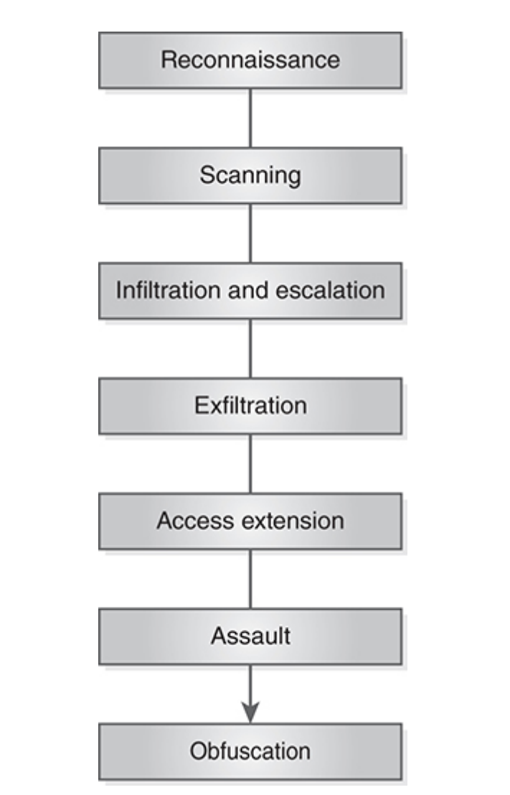
Hacking steps
Reference:
Oriyano, S., & Solomon, M. (2018). Hacker Techniques, Tools, and Incident Handling, 3rd edition
Notes:
When I have so explain an idea that is hard to describe in words or may take many paragraphs I will look for and use reverent pictures and graphics like the one on the slide to show the idea instead of tell it.
When a hacker attempts to attack a computer system, they must follow a set of steps they created or that they learned when becoming a hacker.
If they don’t have a list of steps or not follow them then they might be located and arrested, or simply the attack to fail because of a countermeasure implemented by the target.

Slide 7
Computer Reconnaissance
Reconnaissance is the phase where hackers narrow down their list of potential targets.
When looking for sources or looking through my sources I am looking for parts that cover some of the tools and methods that hackers use to find information about potential targets. I am looking for information and potentially images to explain the idea.
It is done through a process called footprinting, which involves the passive collection of information (information that can be found without interacting the potential target directly).

Slide 8
Computer Reconnaissance
A hacker is required be look for information about a potential vulnerability on a target on lots of websites and using many tools.
This data can be found across the internet from their websites, Google, blogs, social media, news articles, interviews, and many more other places.
The following is the easiest sources of information that can be included in an automated collection software: HTML, Job postings, Financial Information, Google Hacking/Search Engine Hacking, Whois/Nslookup search, Social media posts from known employees.
A Hacker should do this step passively (Not interacting with any of the organization’s staff or password protected systems) because this interactions may be reported to their Cybersecurity team and will be expecting an attack and will have a shorter response time to the attack; reducing the amount of data the hacker could obtain.

Slide 9
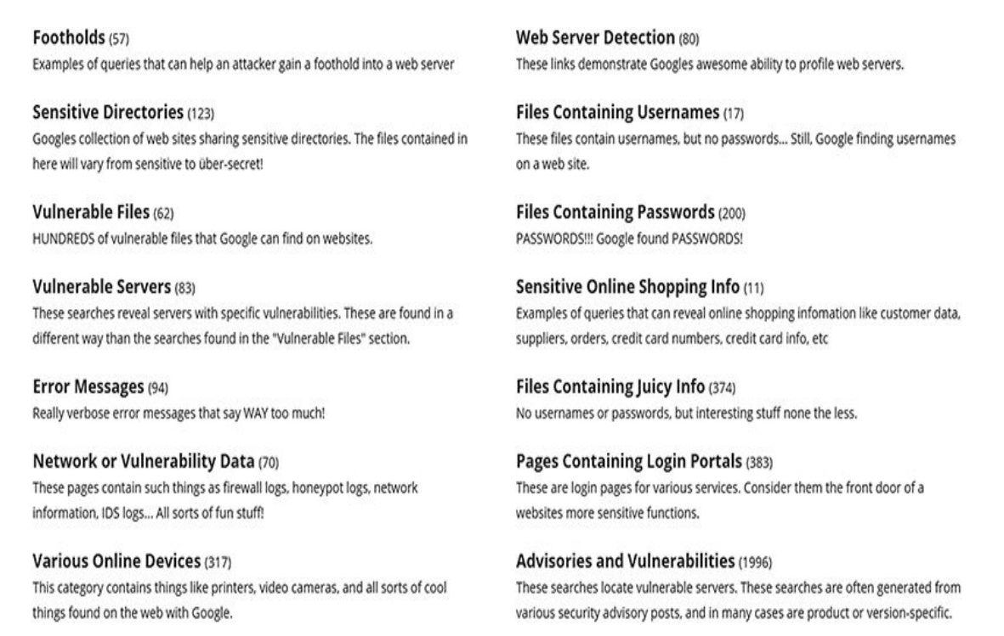
Google Hacking Database (GHDB)
Reference:
Oriyano, S., & Solomon, M. (2018). Hacker Techniques, Tools, and Incident Handling, 3rd edition
Notes:
The Google Hacking Database (GHDB) is one site that lists query templates that identifies sensitive data and content.

Slide 10
Computer Scanning
Scanning is the phase where the target list is reduced. This is done by using information from the last step and using more advanced tools to collect more detailed information about a target's computer network.
When looking for sources or looking through my sources I am looking for parts that cover some of the tools and methods that hackers use to find information about potential targets. I am looking for information and potentially images to explain the idea.
Scanning is done by actively communicating with the target’s computer network to find any potential vulnerabilities that may exist in any of the computers attached to the network.

Slide 11
Computer Scanning
This is the step that involves actively communicating with the victim’s computer network. This is the earliest time target knows that there might be an attack.
The information collected in this step can include: IP addresses of active computers connected to the internet, open ports on those active computers, active services running on those active computers that use those ports.
There any many tools hackers use to do this step with the most known tools and techniques being: Ping Sweep, Nmap, and Nessus.
The purpose of this step is to find out if any computer can be connected to and to know what may be running on that computer to find a potential vulnerability.

Slide 12
Computer Infiltration and Escalation
Infiltration and escalation is the phase of hacking where the best target in the target list is selected for Infiltration and attack, and is attacked; with their data stolen.
When looking for sources or looking through my sources I am looking for parts that cover some of the tools and methods that hackers use to find information about potential targets. I am looking for information and potentially images to explain the idea.
Infiltration and escalation has hackers exploit the vulnerabilities found in the target’s computer network to access their data, and also to gain administrate control to do any action.

Slide 13
Computer Infiltration and Escalation
Hackers must also keep up to date with companies and government agencies to know when a tool or technique has been identified and neutralized.
There are many techniques and tools hackers use to gain access and escalate privileges on a computer. The following is some of the techniques hackers use: Password Crackers, Session hijacking, and Rootkits. The following is some of the tools hackers use for privilege escalation: Active@ Password Changer, Trinity Rescue Kit, ERD Commander, and Recovery Console.
The techniques hackers use to infiltrate a computer can be part of many tools with some being very complex and feature rich, with others being simple and efficient.

